Slide 1
AngularJS
Animation
Lecture 6
By James(Jin) Wang
08/01/2019

Slide 2
Outline
Enhancing the UI with Bootstrap
Animation Overview
The ngAnimate Module
Defining Animations in CSS
Referencing Animation Classes
  Demo: Add Bootstrap

Slide 3
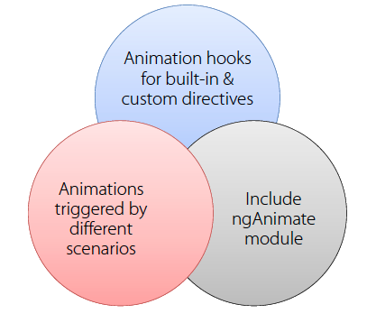
UI and Animation
  Animations in AngularJS:

Slide 4
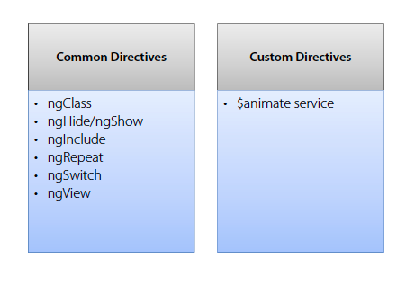
UI and Animation
  Directives and Animations:

Slide 5
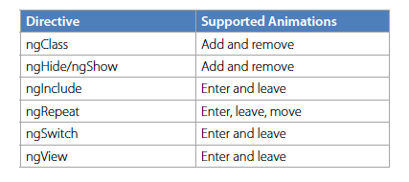
UI and Animation
  Directives and supported Animations:

Slide 6
UI and Animation
  The ngAnimate Module:
  AngularJS animation functionality is located in the ngAnimate module
  Add a <script> that loads angular-animate.js
  Reference ngAnimate in your module:
  Demo: Add ngAnimate

Slide 7
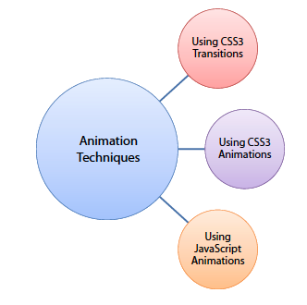
UI and Animation
  Animation Techniques:

Slide 8
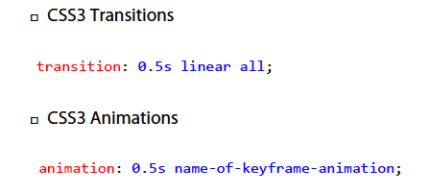
UI and Animation
  Defining Animations with CSS:
  Animations can be defined multiple ways using CSS:

Slide 9
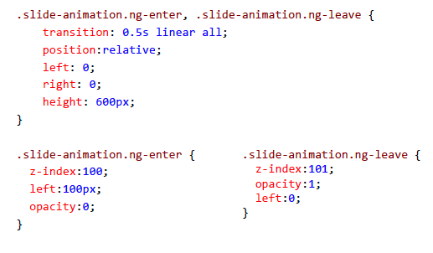
UI and Animation
  CSS Transitions Example:

Slide 10
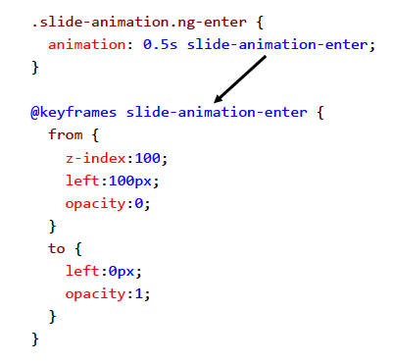
UI and Animation
  CSS Animations Example - Enter:

Slide 11
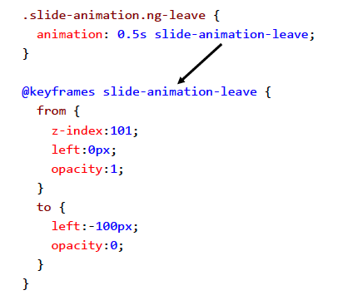
UI and Animation
  CSS Animations Example - Leave:
  Demo: Add animate stylesheet

Slide 12
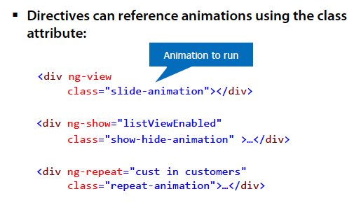
UI and Animation
  Animations Referenced by Class:
  Demo: Hook Directive to Animation

Slide 13
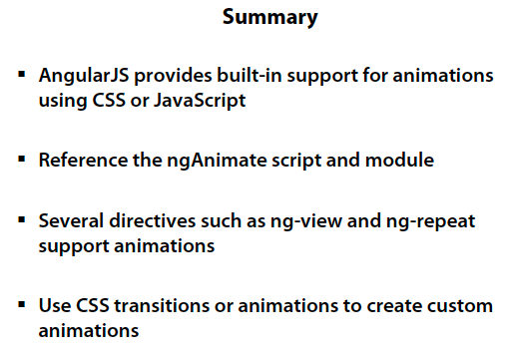
UI and Animation

